Slide 1
Tableau: Joins, Relationships,
Blends, and Unions
Data Analytics

Slide 2



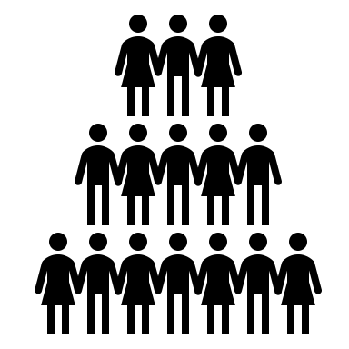






















Common Charts
Data Views
Hierarchies
Data Structures
Basic Navigation
Dashboards
Data Stories
Calculations
Advanced
Charts
Certification Springs
Blending
Done
You are here

Slide 3
Module 10 Learning Outcomes
Understand joins, relationships, and blends in Tableau
Demonstrate creating relationships
Demonstrate blends in Tableau
Demonstrate unions in Tableau

Slide 4

If We Were Using Tableau Desktop
Data Source
Extract
Live Connection
*Tableau Public only uses Extracts
**Aggregation takes a very long time when using a live connection.

Slide 5
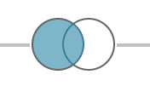
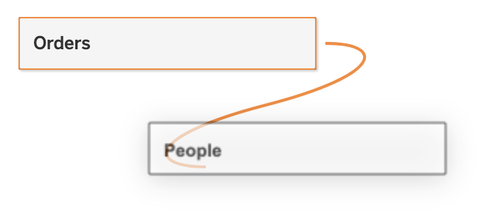

Joins, Relationships, Blends
Joins combine tables by adding more columns of data across similar row structures. This can cause data loss or duplication if tables are at different levels of detail, and joined data sources must be fixed before analysis can begin.
Relationships are the default method and can be used in most instances, including across tables with different levels of detail. Relationships are flexible and are adaptable to the structure of the analysis on a sheet by sheet basis. However, you can't create relationships between tables from published data sources.
Blends, unlike relationships or joins, never truly combine the data. Because of this, blends can handle different levels of detail and working with published data sources. Blends are also established individually on every sheet and can never be published

Slide 6
 | Join | Relationship | Blend
Connection | Strong | Flexible | Casual
Structure | Combined into 1 megatable | Tables are loosely joined, original structure is preserved | Tables remain separate, original structure preserved
Aggregation | Based on join type, granularity | Smart aggregation, contextual joins | Can only aggregate at the level of primary table
Weakness | Possible duplication of information, static structure | *Can’t join on geographic fields, can’t have circular relationships | Left join only (primary table is left)

Slide 7
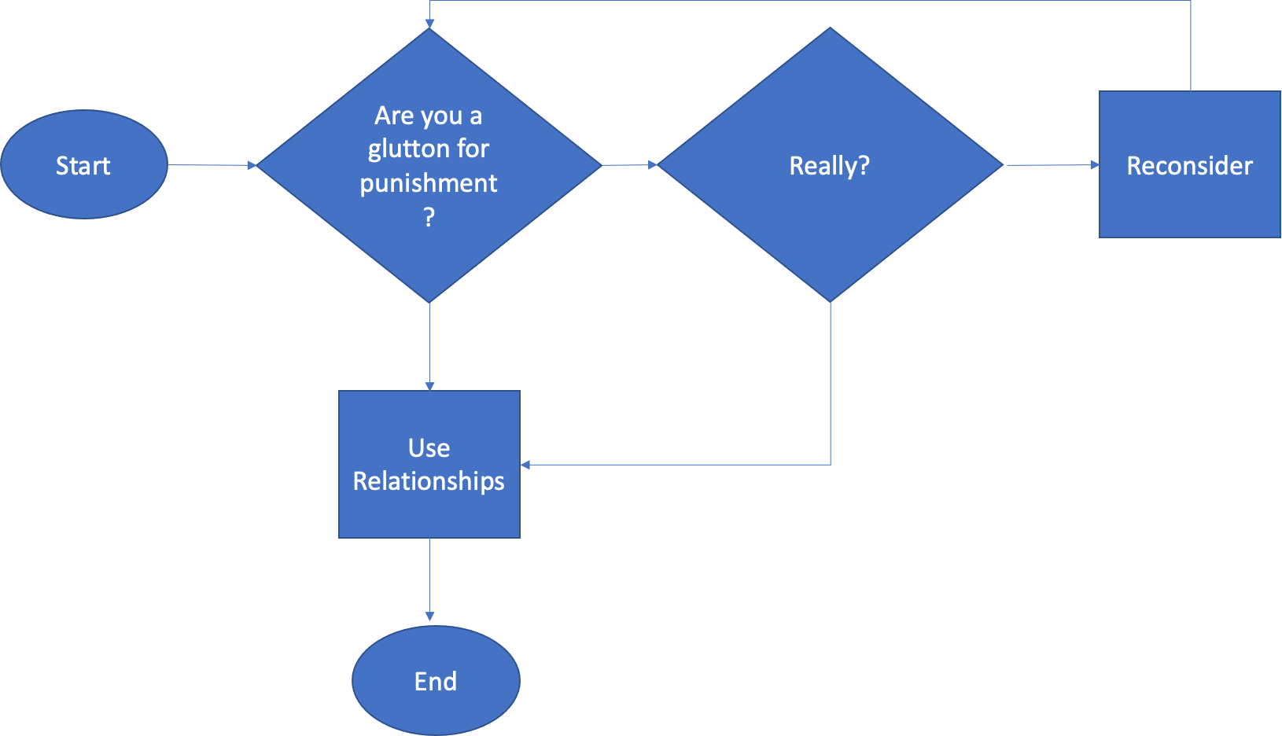

Join, Relationships, or Blend?

Slide 8
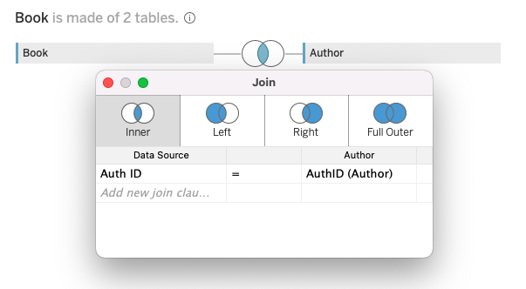
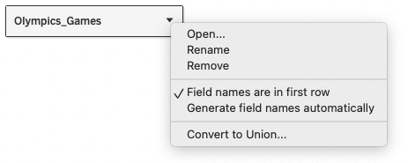
Regular Old Joins In Tableau
Open a file (.xlsx, .csv, .geojson, etc)
Drag a table out into the workspace
Select “open” (or double click)
Drag another table into the workspace
Specify the relationship between the tables

Slide 9
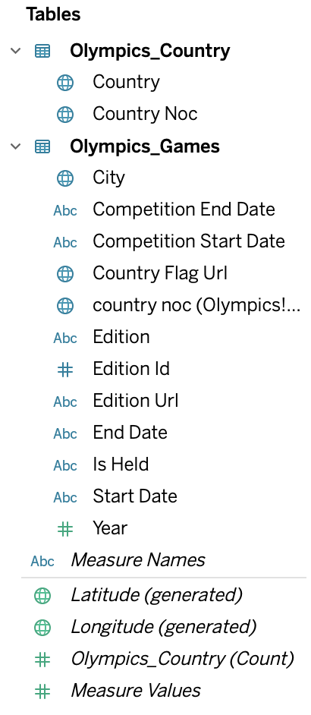

Inner Join vs Left Outer Join
What is the difference between the number of countries we would get with an inner join vs. a left outer join?

Slide 10
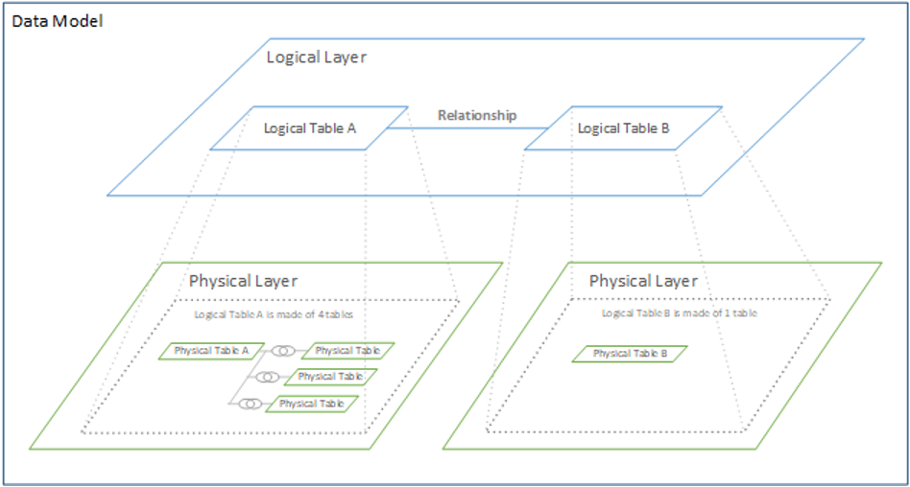
Relationships
Joins

Slide 11
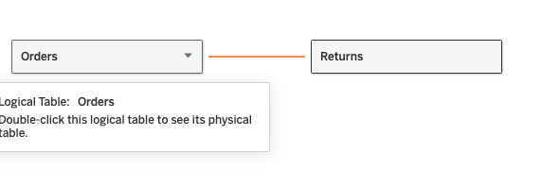
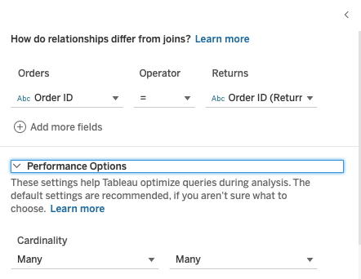
Relationships
Open a file (.xlsx, .csv, .geojson, etc)
Drag a table out into the workspace
Drag another table into the workspace
The ‘noodle’ will appear!
Specify the relationship between the tables

Slide 12
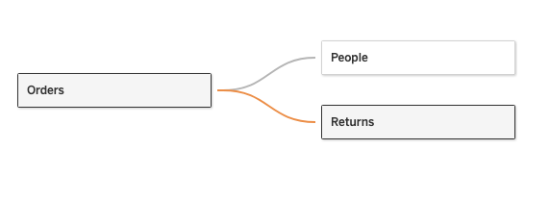
Relationships can be complex (i.e. multiple tables)
The maximum number of 32 tables can be joined in Tableau.
A table size must also be limited to 255 columns (fields).

Slide 13

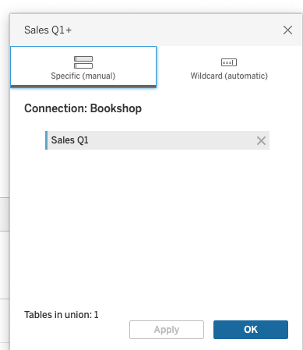
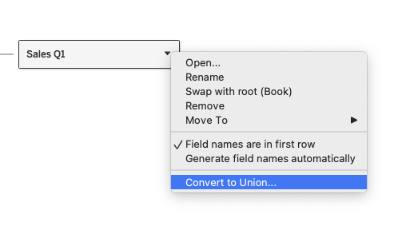
Unions
When tables have the same structure but do not have the same data, create a union instead of a relationship

Slide 14
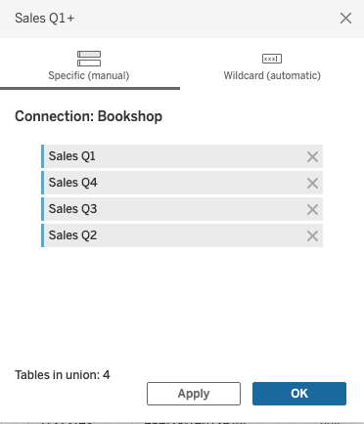
Unions

Slide 15
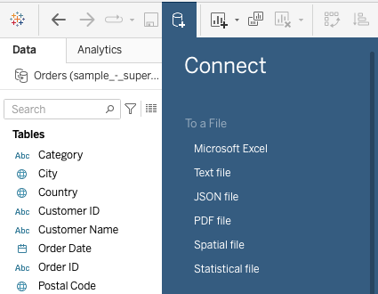

Blends
Click on the connect icon and select another file
Both tables are visible under ‘data’
Selecting data from different tables creates a ‘blend’

Slide 16
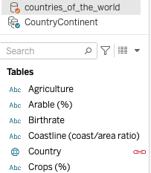
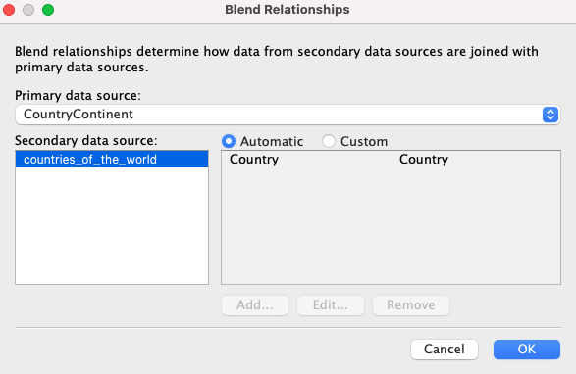
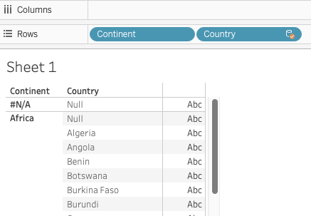
Editing Blends

Slide 17


Exercise (not a Challenge)
Sequence:
Open ‘2012_2016_olympics.xlsx’
Create a union between 2012 and 2016
Rename the union ‘2012 and 2016’
Add ‘Olympics_Country.csv’ table
Create a relationship between the union and the country data
Go to sheet 1
Click on the ‘add data source’ icon
Add a text file: ‘CountryContinent.csv’
Create a blend

Slide 18
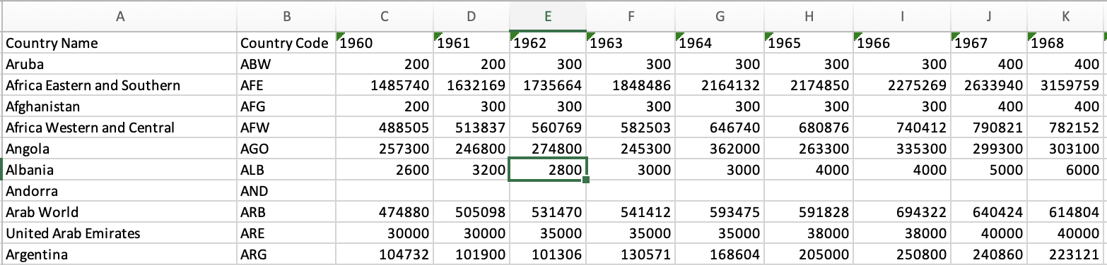
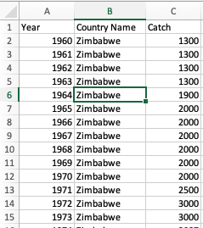
Pivoting in Tableau
We have this
But
We want this

Slide 19
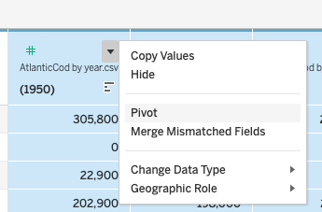
Pivoting in Tableau

Slide 20
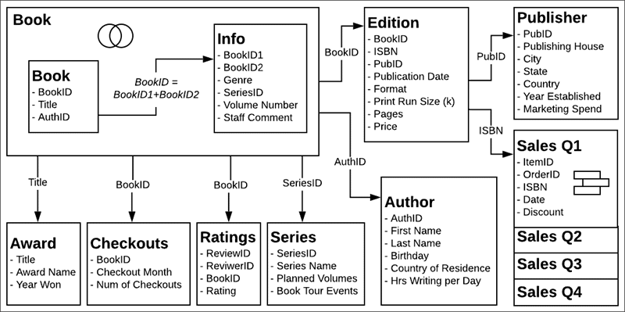
https://help.tableau.com/current/pro/desktop/en-us/bookshop_data.htm

Slide 21
Challenge
Using the Bookstore dataset
Create a left outer join between book and award.
Create a relationship between book, author, edition, and publisher.
(Consult the ERD diagram for the correct sequence)
Create a union of sales for Q1, Q2, Q3, Q4
Create a horizontal bar chart counting total orders for each title, show only the top 10 and use color to indicate publishing house
Create a blend with the Bookstore (primary) and CountryContinent.csv (secondary) connecting continent/country to author country of residence. Create a horizontal bar chart showing count of orders for each continent (based on author continent/country of residence).

